Slide 1



BY SENTHIL KUMARAN.M
Forecasting Household Electricity Consumption with Machine Learning

Slide 2

Introduction
In this presentation, we will explore forecasting household electricity consumption using Machine learning techniques. We will discuss the challenges and opportunities in this ﬁeld and the potential impact on
energy management.

Slide 3
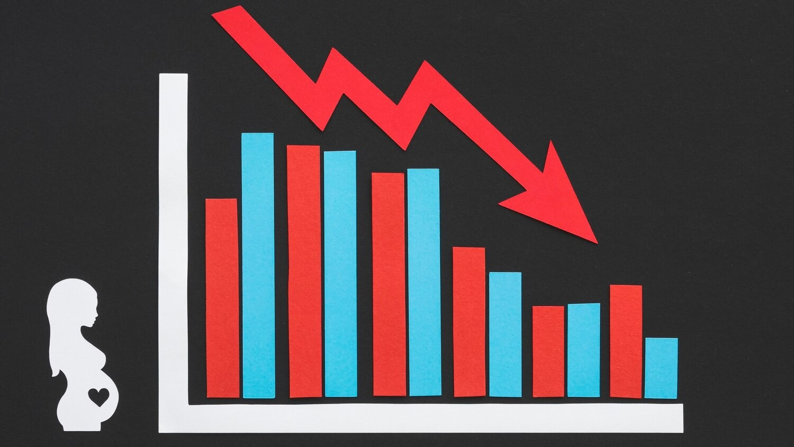
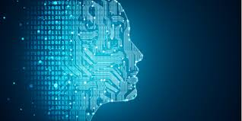
Electricity Consumption
Trends
Understanding the trends in household electricity consumption is crucial for accurate forecasting. We will analyze the seasonal, daily, and hourly variations in consumption patterns, and their implications for
predictive modeling.

Slide 4


Data Collection and Preprocessing
High-quality data is essential for training accurate machine learning models. We will discuss the collection and preprocessing of electricity consumption data, including feature engineering and outlier detection.

Slide 5

Feature Engineering
Eﬀective feature engineering is critical for capturing the complex relationships in electricity consumption data. We will explore various features such as weather conditions, time of day, and appliance usage patterns.

Slide 6

Machine Learning Models
We will delve into the application of machine learning algorithms for electricity consumption forecasting, including regression models, time series analysis, and neural networks. Evaluating model performance and selecting the most suitable approach
will be discussed.

Slide 7

Model Evaluation and
Validation
Assessing the accuracy and reliability of forecasting models is crucial. We will explore evaluation metrics and validaton technniques ensure the robustness of the predictive models.

Slide 8

Challenges and Limitations
Despite the potential of machine learning, there are inherent challenges and limitation in forecasting household electricity consumption. We will address issues such as data scarcity, model interpretability, and scalability.

Slide 9



Case Studies and Applications
Real-world case studies and applications of machine learning in electricity consumption forecasting will be presented. We will examine successful implementations and their impact on energy eﬃciency and demand management.

Slide 10

Future Directions
The future of forecasting household electricity consumption lies in advanced machine learning techniques, integration with smart grids, and the emergence of predictive analytics. We will explore the potential developments and their implications.

Slide 11

Ethical and Social Considerations
As machine learning technologies advance, it is essential to consider the ethical and social implications of electricity consumption forecasting. We will address privacy concerns, equity in energy access, and environmental sustainability.

Slide 12


Conclusion
In conclusion, the application of machine learning in forecasting household electricity consumption holds immense potential for optimizing energy usage and promoting sustainability. The challenges and opportunities discussed pave the way for future advancements in this ﬁeld.

Slide 13
Thank Y0U!

